Slide 1

Infographics: SHOW it
Tricks and Ideas to build your infographic message
Copyright ©2012 by The Source for Learning, Inc. A copy may be downloaded and used by a teacher for single classroom use. NO sharing, network storage, or distribution is permitted. All other rights reserved.
Please respect support TeachersFirst as a free service from a non-profit by directing other teachers to find this show at www.teachersfirst.com/iste/infographics/resources.cfm

Slide 2


SHOW it: What our brains “see”
COLOR
shape
Oh…you wanted me to READ something?
text
Notes:
Infant brains learn to see from very broad to very specific. We “see” things the same way when confronted with visual information. Which do we pay attention to first? Second? Third? Of course, this all happens in a split second, but we ca USE these priorities to direct attention in the things we want to SHOW. Keep this in mind as you start to build your infographic.

Slide 3
SHOW it!
Details and declutter
Relationships
Visual analogies
Essential ingredients
Notes:
Build to SHOW your message, step by step, keeping in mind how brains SEE.

Slide 4
What is your graphic ABOUT?
What are the essential ingredients of xxx ?
What do you picture when you think of xxx?
Essential ingredients
Notes:
Before you start an infographic, stop and ask….

Slide 5
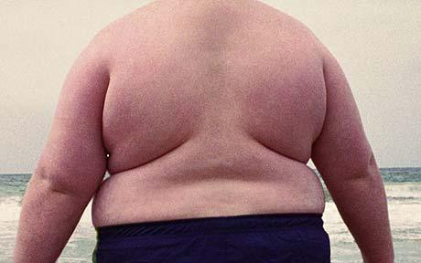
What are the essential ingredients of
The high cost of obesity ?
What do you picture when you think of
obesity and cost?
$
Essential ingredients
Notes:
What does each image SHOW you? Are these the essential ingredients of this concept? (This slide has automatic animation. Let them run by themselves.)

Slide 6
What are the essential ingredients of…
Education?
Air quality?
Cells?
Voters?
Nutrition?
Acceleration?
Carnivores?
Poetry?
What do you picture?
Essential ingredients
Notes:
What picture could show the ESSENTIAL ingredient of each of these? What does your brain picture to SHOW it, instead of SAY it? (This slide has automatic animation. Let them run by themselves.)

Slide 7
Find or make a visual analogy
by combining essential ingredients
$
Visual analogies
Essential ingredients
Notes:
Once you have the essential ingredients, you can find or make a visual analogies by combining the essential ingredients to form part of your message.
(This slide has automatic animation. Let them run by themselves.)

Slide 8
Find or make a visual analogy
by combining essential ingredients
$3.5
billion
Combine and layer (“arrange”) images instead of words
Formatting Palette tools
Picture > format
Picture > effects
Notes:
What does this image SHOW you without SAYING it? What do you notice about the dollar bill, for example? ? (The text boxes give tips on how to make the images look like that in PowerPoint.)

Slide 9
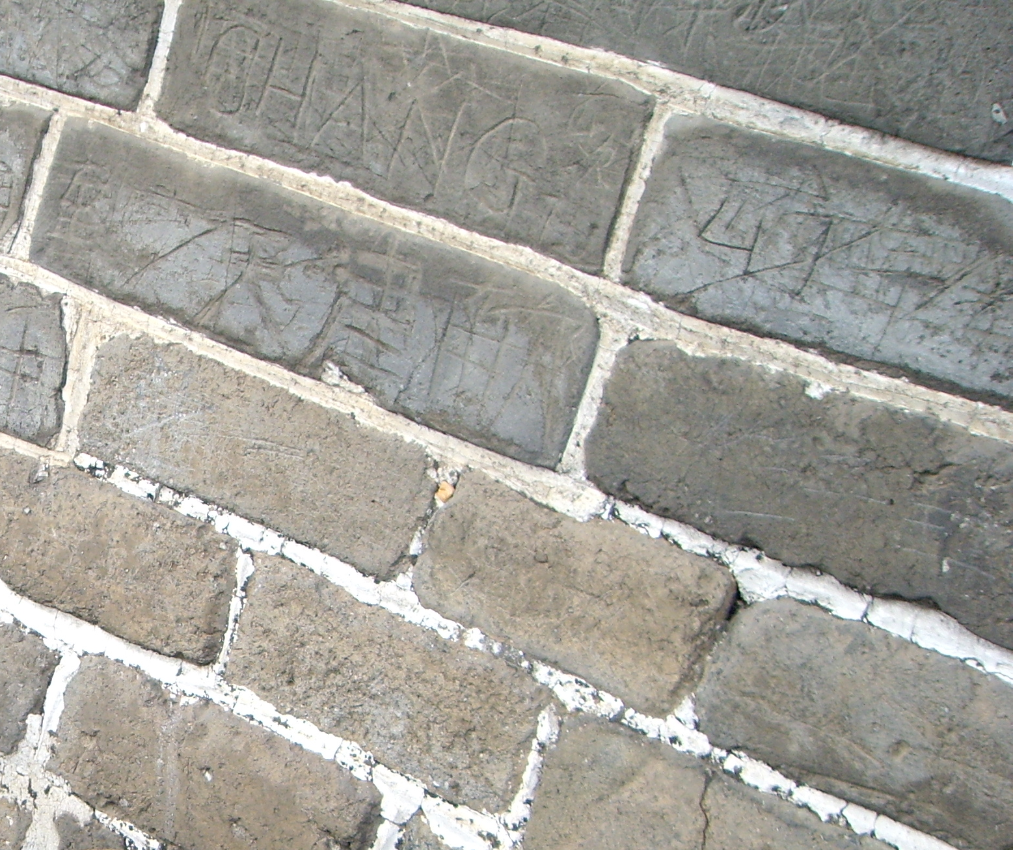
Find or make a visual analogy
Biomolecules
Formatting Palette tools
Picture > crop tool
Picture > transparency, contrast, brightness
Picture > format; various options
Visual analogies
Essential ingredients
Notes:
What does this image say about biomolecules? (The text box tells you how to make the image look like that in PowerPoint.)

Slide 10
What relationships or comparisons do you want to show?
Relationships
Visual analogies
Essential ingredients
Notes:
Now you are ready to SHOW relationships using those visual analogies.

Slide 11
What relationships or comparisons do you want to show?
  numerical differences (age, quantity, cost, etc.)
  size comparison
  cause/effect
  before/after
  first, then, last (step by step)
  families or groups
  contrast/difference
  hierarchy (ranking, importance)
Notes:
Stop to think about what relationships you need to SHOW as part of your message.

Slide 12
Relationship: numerical differences
$100
million
1980
(data is fictitious)
$3.5
billion
2010
Notes:
What SHOWS the comparison or relationship? Which is in front? What do the colors tell us?

Slide 13
PowerPoint tip: SHIFT-click to select multiple items and RIGHT click to GROUP them. (easier to resize!). Ungroup as needed to edit.
$100
million
1980
$3.5
billion
2010

Slide 14
Relationship: contrasts
re
“clean” coal
geothermal
color
color
flip
size
Notes:
What SHOWS a contrast between these two?
(This slide has automatic animation. Let them run by themselves.)

Slide 15
PowerPoint tips: Shift-click and GROUP. Use green dot handle to flip. Drag/copy grouped items easily.Ungroup as needed to edit. Effects > color invert to change colors.
re
“clean” coal
geothermal
Notes:
What SHOWS a contrast between these two?

Slide 16


Relationship: cause>effect
=
geothermal
Notes:
Yes, the clip art is corny, but what is the message? How does it SHOW the relationships?

Slide 17
Autoshapes! Format palette to change color and reinforce relationships. Copy paste trees. Arrange> Bring to front and make larger.
=
geothermal
Notes:
Yes, the clip art is corny, but what is the message? How does it SHOW the relationships?

Slide 18
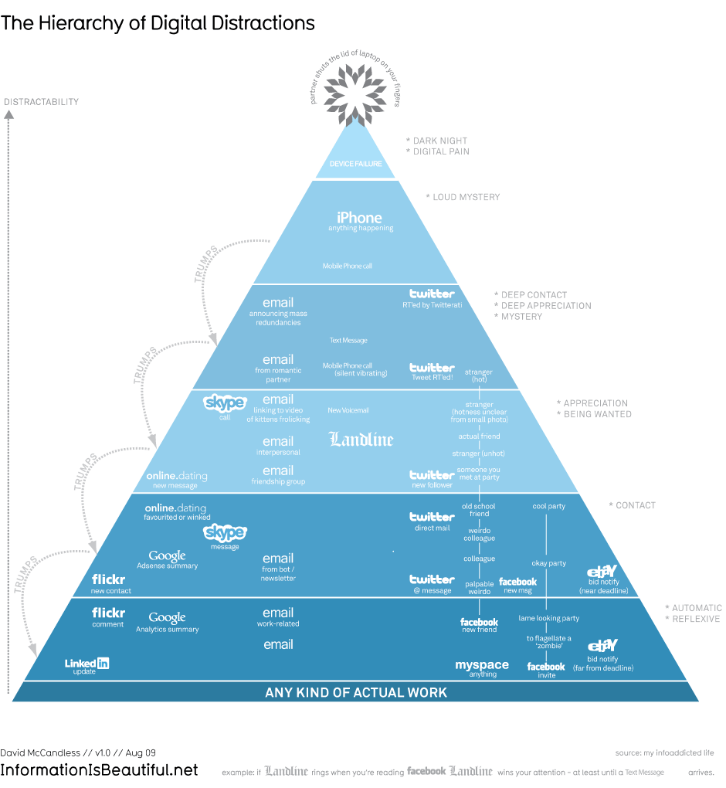
Relationship: hierarchy/importance
Click!
http://www.informationisbeautiful.net/visualizations/the-hierarchy-of-digital-distractions/
Notes:
(click the link) What is it about this simple graphic that SHOWS you what is important?

Slide 19
Relationship: Groups, families
Notes:
Can you guess the “groups” that form these relationships? Hint: wants and…

Slide 20
Relationship: Groups, families
Formatting palette: Effects > false color or any color effect to group graphics using the same color
Notes:
You can use graphics that are all the same color or manipulate the colors to form groups.

Slide 21
How would you SHOW…
  first, then, last
  before/after
Relationships
Notes:
PICTURE in your head how you might use images to SHOW these relationships.

Slide 22
SHOW it!
Details and declutter
Notes:
What details are missing? How can you add them and declutter so the message SHOWS clearly?

Slide 23

Labels, details INSIDE
Harry Campbell in “What’s Wrong with the Teenage Mind?” http://online.wsj.com/article/SB10001424052970203806504577181351486558984.html?mod=WSJ_hp_MIDDLENexttoWhatsNewsTop
Silhouette to layer and declutter
Notes:
(This slide has automatic animation. Let them run by themselves.)

Slide 24
Silhouette to layer, label, and declutter
Notes:
Every shape has meaning.
(This slide has automatic animation. Let them run by themselves.)

Slide 25
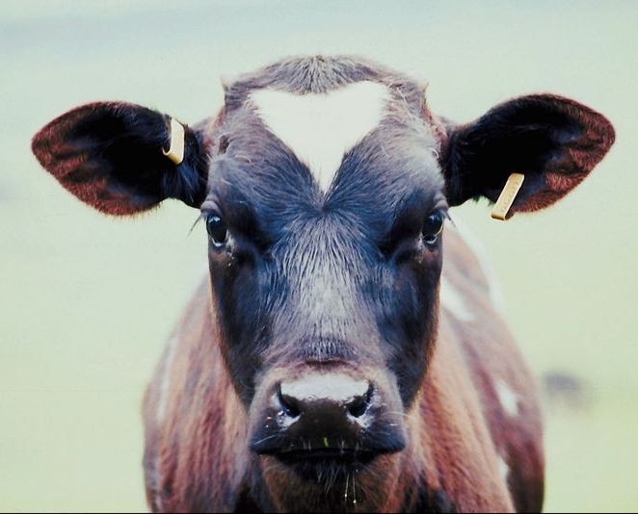
Layer to label and declutter
Format Picture> Recolor> Background color Light
Effects>
Color adjustment
Sepia and transparent
Notes:
How could these effects help you include data without clutter?

Slide 26

Your data here
Add details and declutter using color.
“clean” coal
Notes:
Which color choices help declutter? Why use red for the data? How many colors are being used here?

Slide 27
Details and declutter
Not enough room?
Notes:
This problem happens a lot when you are trying to add data details. What can you do?

Slide 28
Details and declutter
Enlarge a detail!
Notes:
A detail bubble can focus attention and add specific details that would not otherwise fit. This is simply an autoshape “callout” or voice bubble. What other shapes can you use for a detail? How is it “connected” to the main image so we know what it is showing us?

Slide 29
Self-test. Do you remember the steps?
Notes:
Stop and see if you can remember the steps from start to finish to SHOW your message.

Slide 30
Self-test. Do you remember the steps?
Essential ingredients
Notes:
Stop and see if you can remember the steps from start to finish to SHOW your message.

Slide 31
Self-test. Do you remember the steps?
Visual analogies
Essential ingredients

Slide 32
Self-test. Do you remember the steps?
Relationships
Visual analogies
Essential ingredients

Slide 33
Self-test. Do you remember the steps?
Details and declutter
Relationships
Visual analogies
Essential ingredients
Notes:
(This slide has automatic animation. Click to bring in the answers one at a time.)

Slide 34
SHOW it!
Details and declutter
Relationships
Visual analogies
Essential ingredients
Notes:
DONE!

Slide 35
Save as Picture!
PowerPoint slides can be saved as .png image files to be shard on a wiki or inserted into documents. RIGHT click on the slide and choose Save as picture.
Infographic complete?

Slide 36
Self-test:
In what order do our brains “see”?
text
shape
COLOR
Notes:
Can you remember what order your brain sees in? How would you show the importance of these three in the correct order of importance?

Slide 37
Infographics: the message
SHOW
Tell

Slide 38
by Candace Hackett Shively
TeachersFirst.com
Teachers: Use this show in class with the narration/discussion questions included in the NOTES for each slide.
Copyright ©2012 by The Source for Learning, Inc. A copy may be downloaded and used by a teacher for single classroom use. NO sharing, network storage, or distribution is permitted. All other rights reserved.
Please respect support TeachersFirst as a free service from a non-profit by directing other teachers to find this show at www.teachersfirst.com/iste/infographics/resources.cfm

